Slide 1
Winskill Renewal Project
Neighbourhood Information Session #2
6 pm – 8 pm
June 4, 2024
Notes:
JoAnne

Slide 2
Introductions
JoAnne Kleb, Manager of Engagement
Jim Bauer, Director of Capital Projects
Dan Cooper, Director of Parks, Recreation and Culture
Pat Ansell, Director of Parks, Recreation and Culture
Felise Yaco, Engagement Coordinator
Notes:
JoAnne

Slide 3
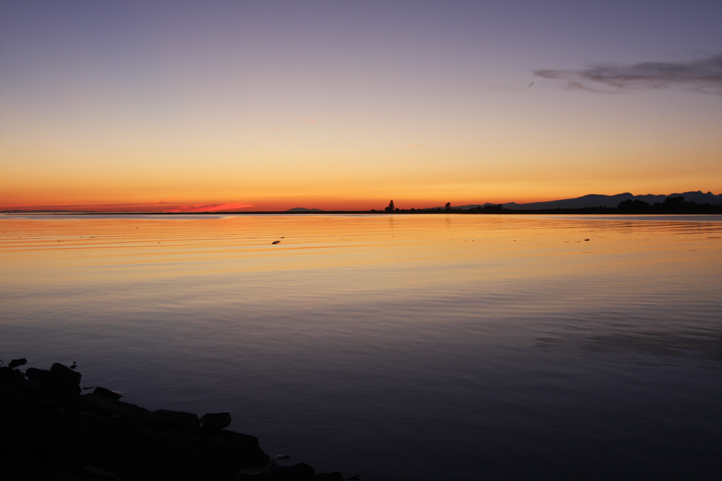
The City of Delta acknowledges that we are on the shared, traditional, ancestral, and unceded territories of the scəw̓aθən (Tsawwassen), xʷməθkʷəy̓əm (Musqueam), and other Coast Salish Peoples. We extend our appreciation to these First Nations for the opportunity to enjoy this land together.
Notes:
JoAnne
Before we begin, we wanted to start with a land acknowledgement as Council does at the start of each Council meeting. Given the subject matter of tonight’s presentation it is all the more important to acknowledge….

Slide 4
Our Goals
Start a conversation about the project with neighbours
Answer questions with info we have today
Gather input on key features
Surface issues and opportunities
Agenda
Project Background
Engagement Plan
Big Decisions
Site Location
Discussion
Notes:
JoAnne

Slide 5
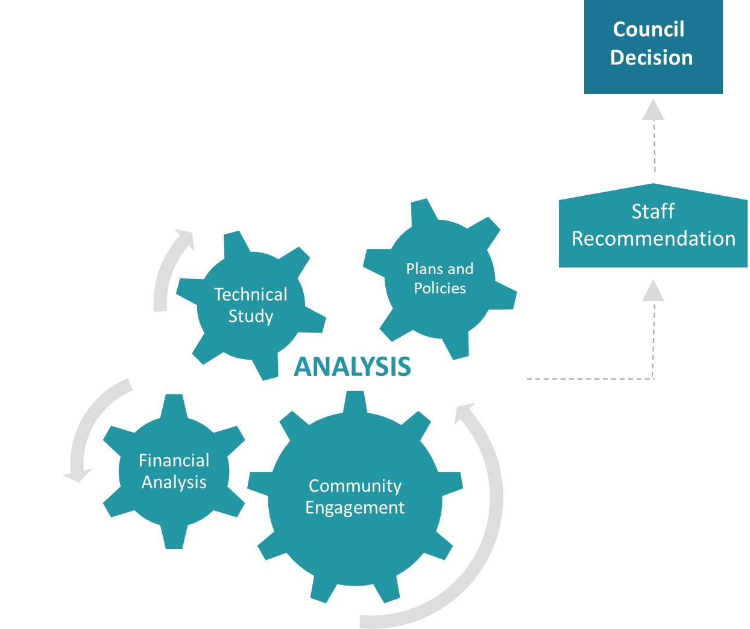
Feedback informs Council decision
Notes:
JoAnne

Slide 6
Tips for Participants
Short presentation followed by Q&A
Be considerate
Treat all participants with respect
Value a diversity of views and opinions
Be brief and stay on topic
Notes:
JoAnne

Slide 7
Project Background
Notes:
Jim

Slide 8
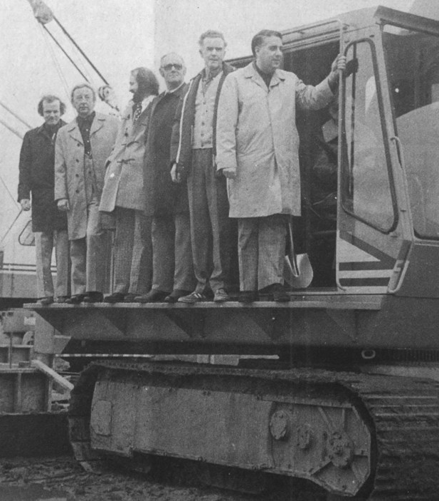
About Winskill Aquatic & Fitness Centre
Built in 1976 and features
  6-lane lap pool
  Teach pool
  Swirl pool sauna
  Weight room
  Fitness studio
  Multi-purpose room

Slide 9
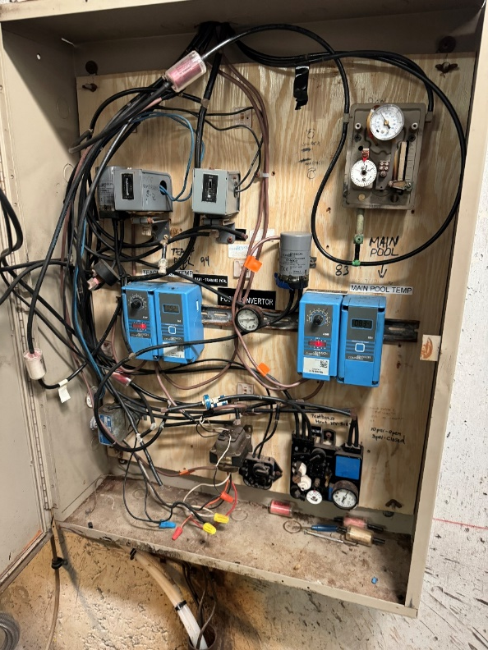
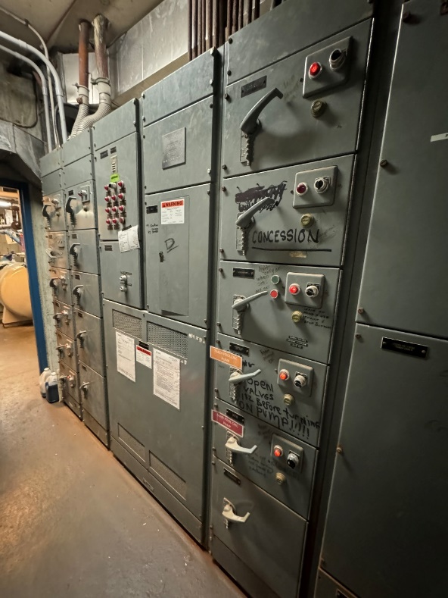
Time to replace Winskill
Study in 2019 showed mechanical systems are at the end of their service life and facility does not meet current building codes

Slide 10
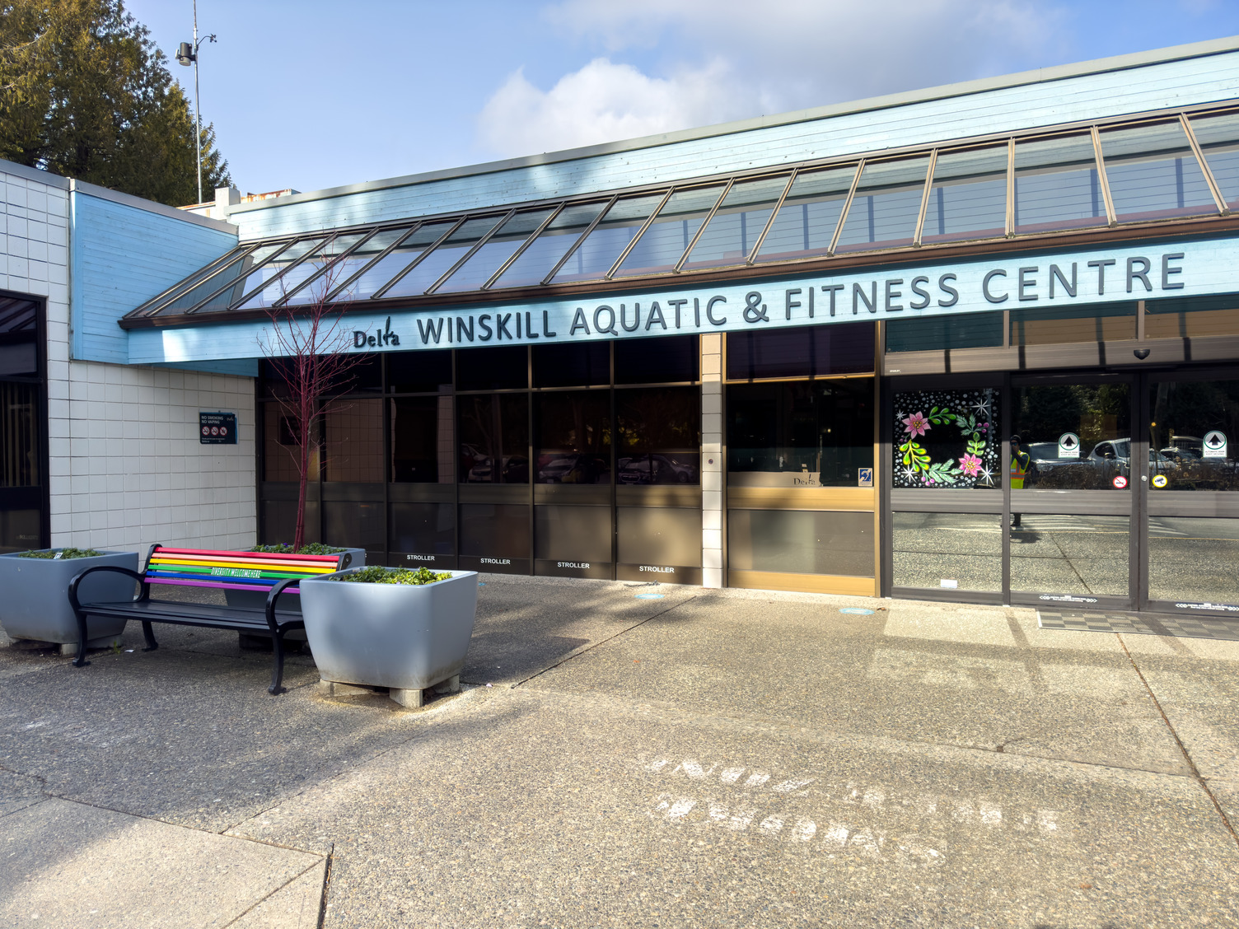
Council direction to build new
Recent estimate showed costs to renovate comparable to cost to build new
Unanimous decision to build new

Slide 11
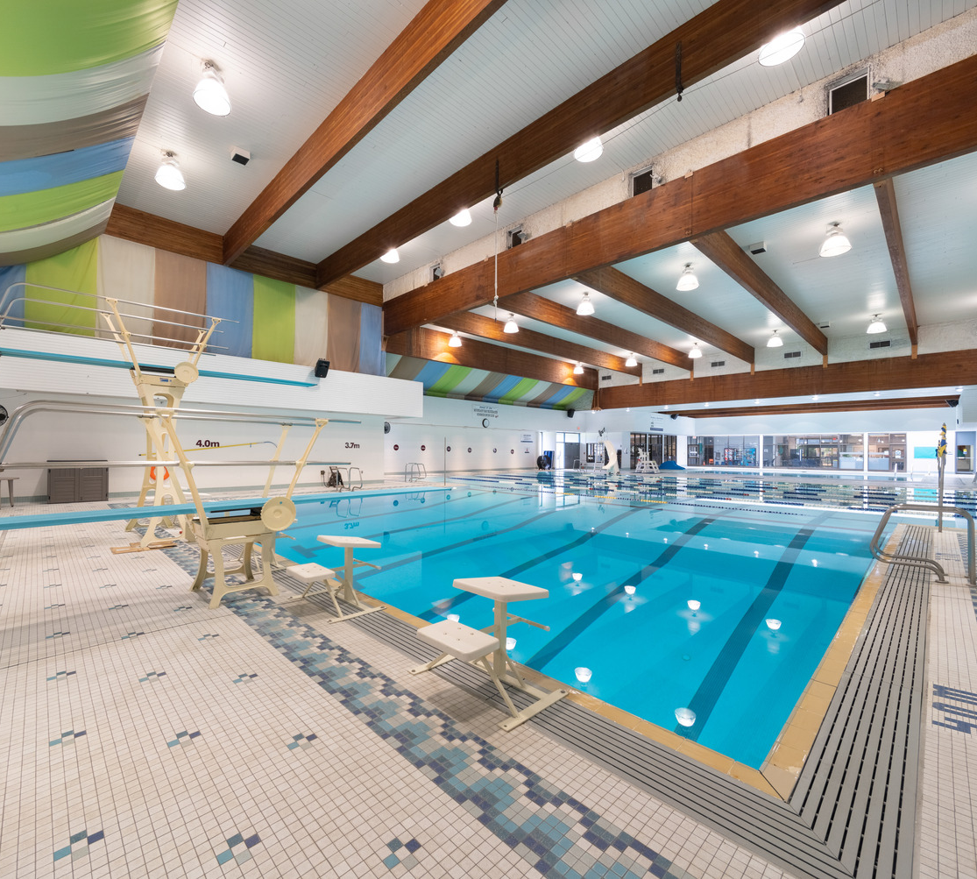
Building for the future
Estimate of $120-$130M
Lap pool (8 to 10 lanes)
Leisure and teach pools
Accessible hot tub, sauna and steam room
1m and 3m diving boards
Fully equipped fitness centre
Gym and multi-purpose spaces

Slide 12

Project team selected
Unitech Construction Management
Dialog/Carscadden Architects

Slide 13
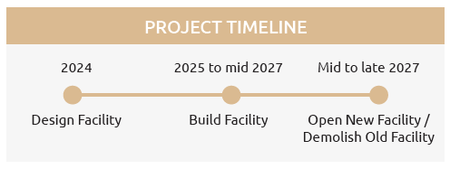
Project Timeline

Slide 14
Engagement Plan
Notes:
JoAnne

Slide 15
Many groups interested
Overall | Equity Deserving Groups | Aquatic | Field | Prospective / Special | Staff/Facility
Community Indigenous Adjacent Residents Adjacent Bus./Org. | Youth Seniors Neuordivergent Immigrants LGBQT2S+ People with Mobility Challenges People with Experience of Poverty | Boundary Bay Bluebacks Swim Club Ladner Stingrays Swim Club Winskill Dolphins Swim Club Winskill Otters Swim Club BC Special Olympics Swim Group | Delta Fastpitch Association Tsawwassen Amateur Baseball South Delta Little League Baseball Tsawwassen Masters Slopitch Tsawwassen Mixed Slopitch 25+ Delta Field Lacrosse - Footmen Tsawwassen Lawn Bowling Disc Golf | Water Polo South Delta Outdoor Volleyball Courts Boys & Girls Club of the South Coast | Aquatic Facility Operations Clerical Fitness Community Recreation Maintenance

Slide 16
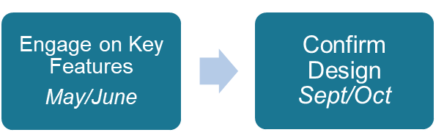
At-a-glance

Slide 17
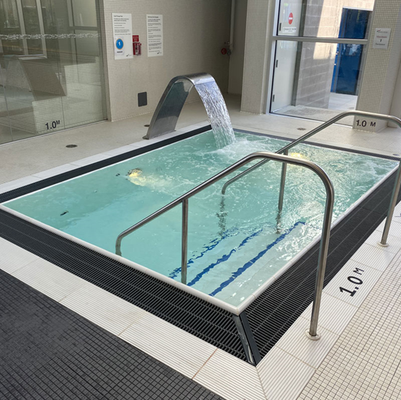
Community invited to get involved
Project vision and priorities
8 or 10 swim lanes for the main pool
Features and attractions
Accessibility and sustainability
Health and wellness features
Location in Winskill Park
Project impacts and mitigation efforts
Page 9
Notes:
Deanie Presents

Slide 18
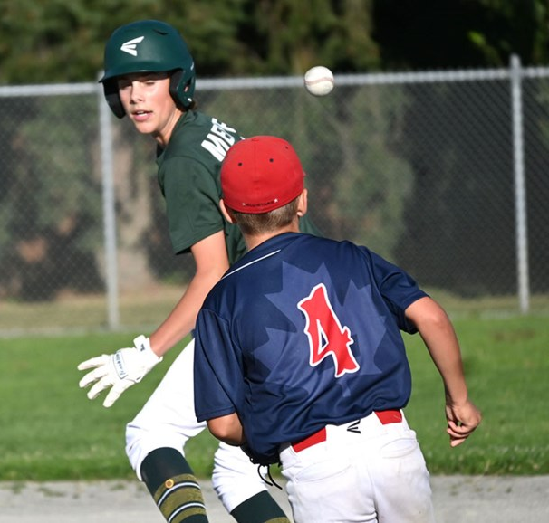
Special events for user groups
Workshops with aquatic and field user groups
Pop-up events with schools and senior centres
Community conversations with underrepresented groups

Slide 19
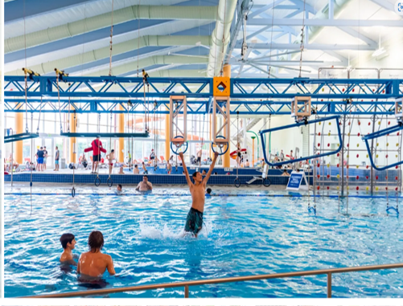
Opportunities for community
Multiple open houses for the public
Information sessions for neighbouring residents
Online feedback form at letstalk.delta.ca/Winskill

Slide 20
Mark your calendar
Date | Venue
May 30, 2024 | Neighbourhood Information Session #1 Winskill Park Fieldhouse 6 pm to 8 pm
June 1, 2024 | Open House #1 – Outdoors Winskill Park 10 am to 2 pm
June 4, 2024 | Neighbourhood Information Session #2 Winskill Park Fieldhouse 6 pm to 8 pm
June 6, 2024 | Open House #2 - Indoors South Delta Recreation Centre 6 pm to 8 pm

Slide 21
Big Decisions Ahead
Notes:
Jim Bauer

Slide 22
Big decisions ahead
Exciting new amenity that will serve the growing community for decades to come
Along with the benefits and opportunities of a project of this scale, there are also impacts for the community
  New location to keep current facility open during construction
  Option of building up to 10 lanes to support growth
  Option of adding 4th ball diamond to meet demand
  Address community impacts:
    Need to relocate disc golf course
    Need to remove and replace trees
    Need to accommodate user groups in adjacent annex building
    Need to relocate ball diamonds on site
    Need to plan for construction

Slide 23
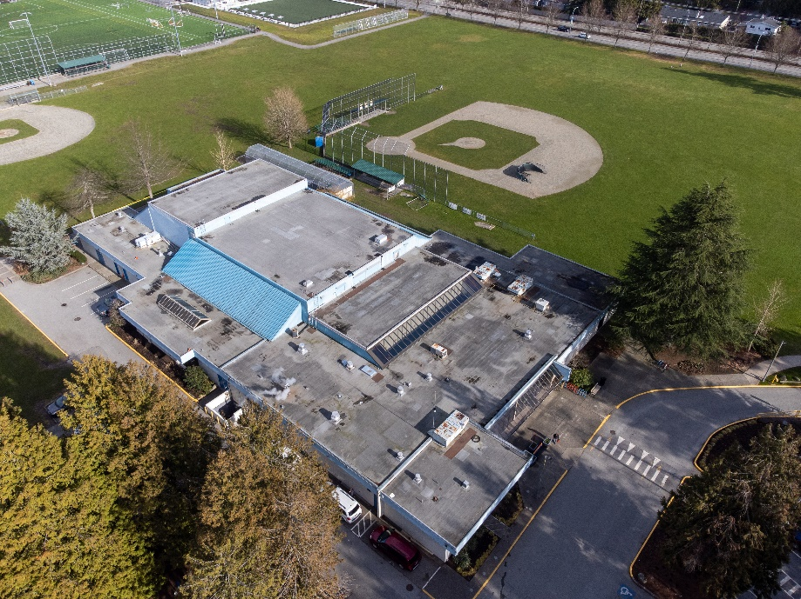
Choosing a location
Goal is to keep current facility open during construction
Need to select new location in Winskill Park
Three options prepared for community engagement
Seeking community input

Slide 24
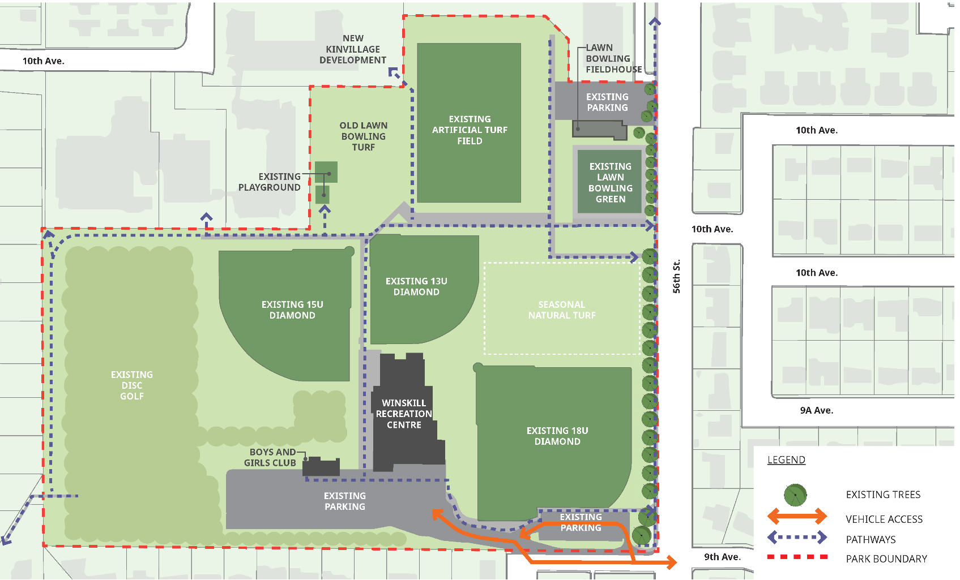
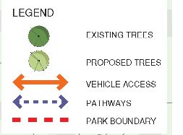
Current
Site
Notes:
Slide 16- 19: Suggest making text more visible for folks with eyesight trouble.
Also could be helpful to make the color of the “proposed buildings” brighter and stand out more so it’s easy for residents to read and match the building labels in the map to what the title says.
(ex. Slide 16: changing “winskill recreation centre” to “Current Site”

Slide 25
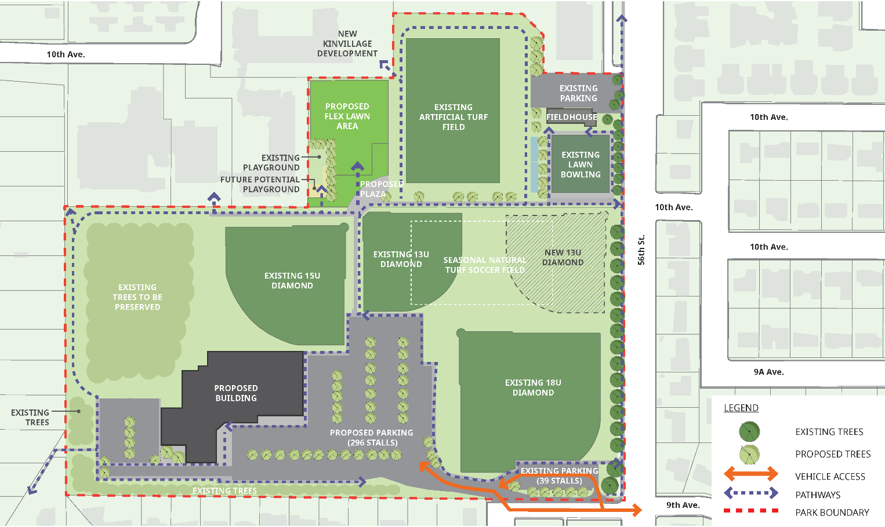

Option 1 - West
Old lawn bowling site proposed as flex lawn area
3 ball diamonds maintained
Option for 4th ball diamond
Tree replacement needed
New location needed for disc golf
Central parking
Intersection at 9th Ave remains as is today

Slide 26
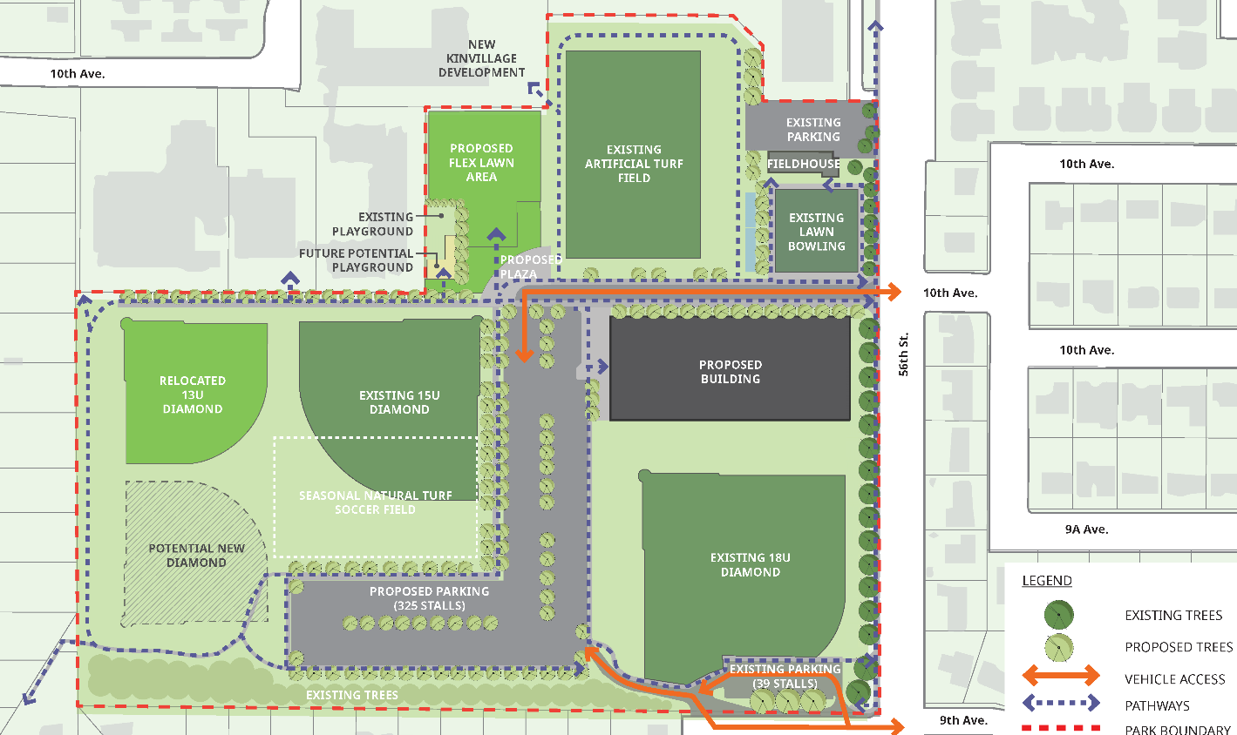
Option 2 - North
Old lawn bowling site proposed as flex lawn area
3 ball diamonds maintained
New intersection needed at 10th Ave and 56th St
Relocation of
13U ball diamond to NW corner
Option for 4th ball diamond
Tree replacement needed
New location needed for disc golf
Central parking
Intersection at 9th Ave remains as is today

Slide 27
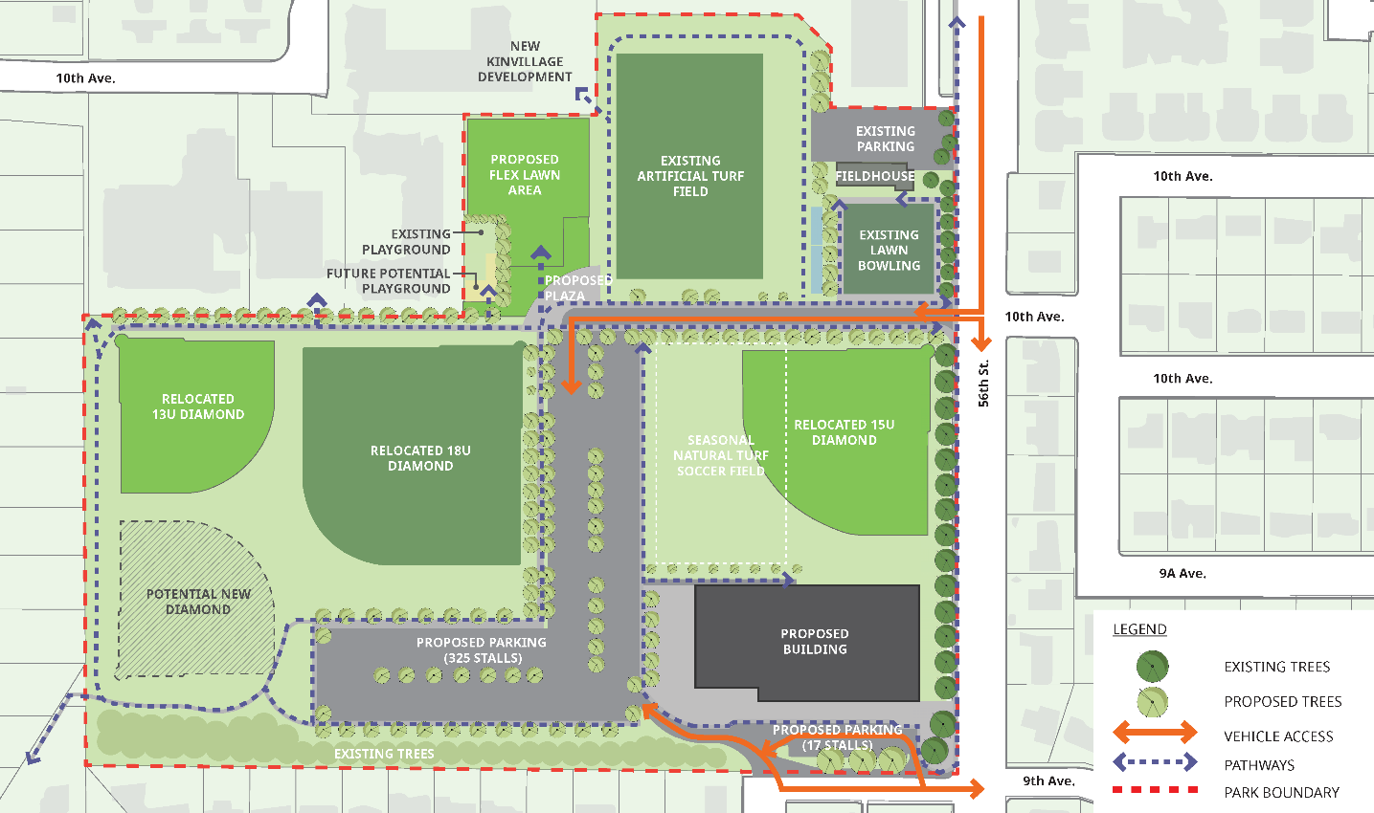
Option 3 - South
Old lawn bowling site proposed as flex lawn area
3 ball diamonds maintained
New right-in/right-out access at 10th Ave and 56th St
Relocation of 13U ball diamond to
NW corner
Option for 4th ball diamond
Tree replacement needed
New location needed for disc golf
Central parking
Intersection at 9th Ave remains as is today
Notes:
Suggest changing “proposed building” to Option 3

Slide 28
Let’s Discuss
Raise your hand
We will come to you
Stay on topic
Be brief
Be respectful

Slide 29

Have your say!
Go to letstalk.delta.ca/Winskill
Complete a feedback form before June 16

